Slide 1

Compass
Gen AI Powered Pre-Call Analysis Tool

Slide 2
Compass Overview
Overview:
Compass is a Gen AI powered pre-call analysis tool that improves cash and aging KPIs
How it works :
This Gen AI powered tool combines our existing automation capabilities (like Alt + K tool & website automations) with our new Generative AI capabilities to
Pull static information from ACE
Review and generate a summarized view of the information and recommend potential next step
Generate talking points for voice processes
Proposed Business Benefits:
Help saving 1 to 1.5 minutes for each account.
Help reduce human errors that leads to multi touch

Slide 3

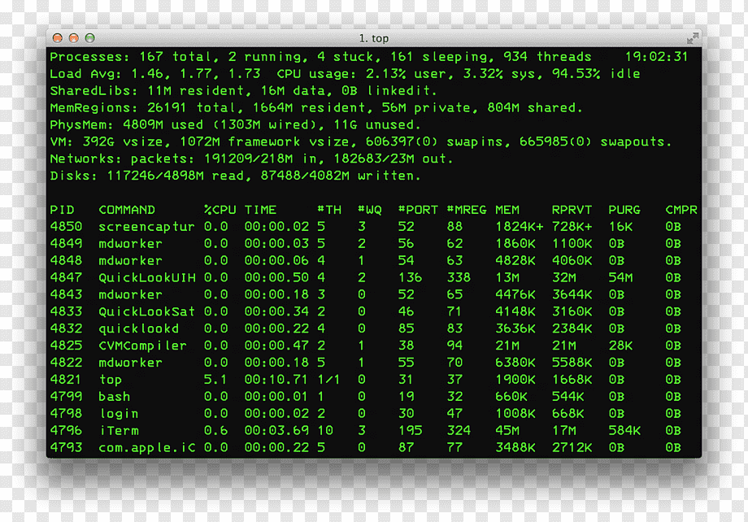


Proposed Process Flow – Associate
Existing feature
Partially Existing
New Feature
No
Associate
Choose next allocated Account
View All Required information including
Overall Summary & Recommended Next Best Action
Call Needed?
View Pre-Call info, make the call
Add Documentation Data
Is Workable Account?
Summarize Data based on Rules
Yes
Compass Tool
Compile Pre-Call Summary Data
No
Update Account Status (Release or On Hold) in workflow tool
Yes
Remove any
PII/ PHI Elements
Remove any
PII/ PHI Elements
Load Staged Data from Compass DB
Merge Stage + Real Time Data
Current Release
ACE
ACE
Fetch data (specific data elements only) real-time & Merge
ACE Notes posting
Open AI
Summarize Activity Notes
Identify Next Best Action
Generate Recommended Conversation Flow
Websites
Fetch Specific Details for given account number
Future

Slide 4
Proposed Process Flow – Pre-Loader
Existing feature
Partially Existing
New Feature
Compass Tool
When all account details are loaded
For each account from inflow
Starts on Scheduled Interval
Is this first run for the day?
Ends
Yes
Wipes staged data
No
Insert/Update Stage Data
Current Release
Fetch Specific Details for given account number
ACE
Websites
Fetch Specific Details for given account number
Future Release

Slide 5

Demo

Slide 6
Additional Information
Pre-Requisites
Assumptions
Clear documentation of each data elements and how it would be used by associate to decide next best action for each process.
Dedicated BOT Login for fetching data from ACE (& other support applications).
Access to ACE model environment
Inflow accounts list would be available on the workflow tool at least three hours before shift starts.
A scheduled Pre-Loader BOT will fetch data (for these list of accounts from Inflow) from ACE (& other support applications in future release) and stage it in Compass DB.
The Pre-Loader BOT runs every 4 hour for each process. During that time, it will request for a pre-defined number (Based on 5 hours of Productivity of that process with the standard head count) of accounts from the allocation queue and load the data for that set.
When associate opens the account, this staged data will be shown. Some of the data elements (to be identified part of discovery) will be fetched from ACE in real-time and override the staged values.
Summarization will be done Realtime based on the data that is displayed to the associate.
For first release, only ACE Integration is planned. Remaining websites integration will be scheduled for future releases.
The staged data will be cleared before reloading the next day’s schedule.
Pending Feasibility Check
With the introduction of Conifer non-persistent VDI, we have to validate all required ACE automation operations shall be done using IBM I Access Client Solutions (ACS).

Slide 7

Q&A/Open Discussion/Next Steps

Slide 9
Compass Delivery Plan – With ACE Integration
Status update
Milestone
WEEK | 0 | 1 | 2 | 3 | 4 | 5 | 6 | 7 | 8 | 9 | 10 | 11 | 12 | 13 | 14 | 15 | 16 | 17 | 18 | 19 | 20 | 21 | 22
Environment Setup
Discovery
Design
Development
UAT
Go Live
Fine Tuning
`
`
`
`
`
`
`
Implementation : 3 to 4 months
Fine Tuning/ Hypercare : 4 to 6 Weeks
Implementation Cost (One-Time)
Steady State Cost (Monthly)
Assumptions
Non-Labor cost is indicative. This will be billed by Nucleus Azure team on monthly basis
Target Users: ~1000 users (Up to 70% of them are concurrent users).
 | Automation | Gen AI | Combined
Labor Cost | $ 121,288 | $ 89,339 | $ 210,627
Non-Labor Cost | $ 4,500 | $ 18,000 | $ 22,500
 | Automation | Gen AI | Combined
Labor Cost | $ 2,500 | $ 3,000 | $ 5,500
Non-Labor Cost | $ 500 | $ 4,000 | $ 4,500

Slide 10
M E S H - Multi-modal Exo SHield for Gen AI
09/01/2023

Slide 11
M E S H (Multi-model Exo SHield) for Gen AI : Overview
Recent Technology breakthrough in AI Field:
In the recent past several powerful GenAI models were released for various domains / specializations (Medical: Med-PaLM, Finance: Bloomberg GPT, Legal: Claude etc.,)
Existing Industry Challenges:
Publicly available models from OpenAI and other LLMs are powerful but most of the organizations want to stay away from it as it poses serious threat in terms of potential IP Infringement, exposing sensitive information and uncontrolled usage.
Solutions conceptualised:
A comprehensive solution which can connect Internal applications with external Generative AI and ensure the predefined policies are strictly adhered and no unwanted data is getting exchanged.
How M E S H works:
Similar like ZScaler (Cloud Security Zero Trust tool) in our systems which keeps the guards up and protects our systems irrespective of whether we connect to office network or a coffeeshop network outside.
M E S H Benefits:
Easily pluggable solution which can be used to connect any Public Generative AI with organisation wide policy adherence.

Slide 12









GenAI: Current scenario
:: Accessing public GenAI models and challenges ::
:: Top 10 Generative AI related risks for organizations ::
Organization
Public
Gen AI Models
TEXT
Documents: Potential IP Infringement
Emails : Sensitive info leakage
Data base: Data exposure vulnerability
Users : Uncontrolled usage
Unprotected Direct connect
Major Target to address
Data security & Mitigate bias
:: Secure transmission with M E S H (Multi-model Exo SHield) ::
Fact Sheet !!
In the recent past several powerful GenAI models were released.
Multiple GenAI models are available for various domains / specializations
(Medical: Med-PaLM, Finance: Bloomberg GPT, Legal: Claude)
Need safe and secure mechanism to use the power of Gen AI models
Organization
Public
Gen AI Models
TEXT
M
E
S
H
:: Key highlights and Benefits of “M E S H” ::
Freedom to connect any Public Generative AI with secure data transmission
No need of having costlier infra for Local Gen AI deployment
Easily pluggable for existing solutions
No implementation challenges
Configurable Policy measures and regulations
Protect info and ensure Policy adherence
* M E S H : New offering of NTT Data for Safe and Secure Gen AI connect

Slide 13
Proposed Process Flow – High Level
Existing feature
Partially Existing
New Feature
Logs in to Compass Tool
Associates
No
View Summary, and decide what to do next
Call Needed?
View Pre-Call Summary, Recommended Conversation Flow and make the call
Input Activity Summary notes, Choose Activity done
Choose next allocated Account
Yes
Is Workable Account?
Compass Tool
No
Summarize Activities history using
Azure Open AI
Compile Pre-Call Summary Data
ACE Notes posting
Update Account Status (Release or On Hold) in workflow tool
Yes
Load Staged Data from Compass DB
Fetch ACE data (specific data elements only) real-time
Generate Recommended Conversation Flow using
Azure Open AI

Slide 14
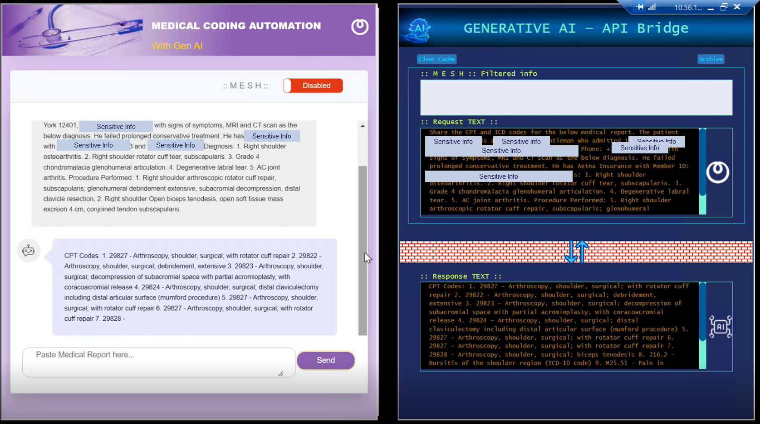
MESH Disabled
Sensitive Data unintentionally leaked to outside world

Slide 15
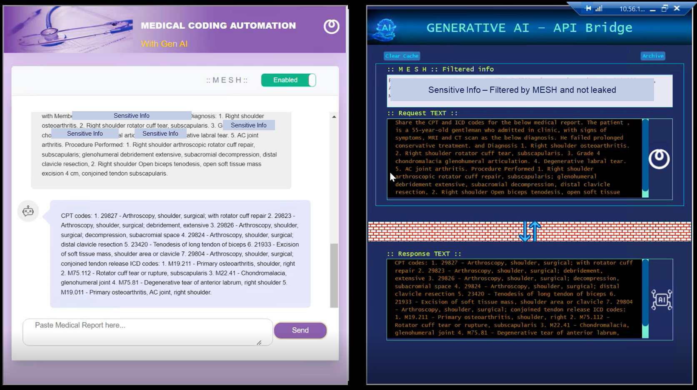
MESH Enabled
No sensitive data unintentionally leaked to outside world

Slide 16

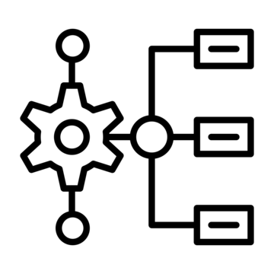



Solution Approach
Pre Loader
Workflow
Open AI Engine
Existing feature
Partially Existing
New Feature
Associates
Start
Fetch Inflow Accounts
Summarization Engine
ACE
M.E.S.H
Convo Generation Engine
Compass Tool
Compass User Interface
Fetch All Account Details
For each account from inflow
Fetch Specific Details for given account number
Core Engine
Post Notes to ACE
API Layer
Staging DB
When all account details are loaded
Store Account Details
Orchestration Engine
Stop
Fetch Detail by Account Number

Slide 17
Solution Approach
Pre Loader
Existing feature
Partially Existing
New (Phase 1)
New (Future Phases)
Core Engine
Staging DB
API Layer
Associates
Compass Tool
Store Account Details
Fetch Detail by Account Number
Orchestration Engine
Compass User Interface
M.E.S.H
API Connector
Website Connector
ACE Connector
Workflow
Fetch All Account Details
Open AI Service
Fetch All Account Details
Convo Generation Engine
Websites
ACE
Fetch Inflow Accounts
Fetch Specific Details for given account number
Fetch Specific Details for given account number
Summarization Engine
Post Notes to ACE

Slide 18
Deployment Architecture
Can be removed as this is covered in component view
Currently this setup (except Azure Services) is in PTC and expected to move to Nucleus Azure before we deploy this tool

Slide 19
Components View
Assumptions:
Required details will be pre-loaded by running a data loader utility from one or more dedicated associates for the accounts in pipeline – 1 hour refresh
When associate opens the account, information would be shown from the pre-loaded data. Associate will have an option to refresh the data real-time as needed.
This manual refresh will be for specific tab to reduce the wait time.
Summarization would be done on Realtime based on the available data.
In case user would like to update any missing data, they can do that as well and recheck summarization.
Target accounts will be fetched from DBPMS or DCM.
Any inputs to Gen AI services, will use Nucleus Mesh Gateway which ensures no PI information is passing through Gen AI Systems.
Can be removed as this is covered in component view

Slide 20
Business Objectives
Description:
Pre-call analysis is a crucial step in resolving the accounts in first pass and would be a critical driver for improving cash and aging KPIs. Depending on the tenure of the agent, this pre-call analysis can take anywhere from 2 to 15 minutes.
At present user must navigate to different screens in ACE and other applications to fetch required information before an account can be worked. We see an opportunity to improve resolution of accounts if we implement a Gen AI based Intelligent summarizing solution that will pre-fetch all required information from account history and supporting applications, apply relevant knowledge articles and provide guidelines for possible next steps if it can identify.
Benefits:
Implementing a Gen AI powered Assistant will help achieve:
Improved quality & productivity
Reduce number of touches
Increase cash/Improved AR days and aging
Reduce ramp up time
Can be removed as the details are captured in new overview slide.

Slide 21
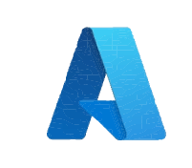




Components View
Conifer VDI in NTT Devices
Compass Tool Core Components
Core Components
Azure OpenAI Engine
Temp working slide
Associates

Slide 22





Components View
Compass Tool
Summarization Engine
Connector Switch
ACE Connector
M.E.S.H
Conifer VDI
API
Website Connectors
API Connector
Compass Tool Core Components
Associates
Pre-Loader Engine

Slide 23
Proposed Process Flow
Can be removed

Slide 24

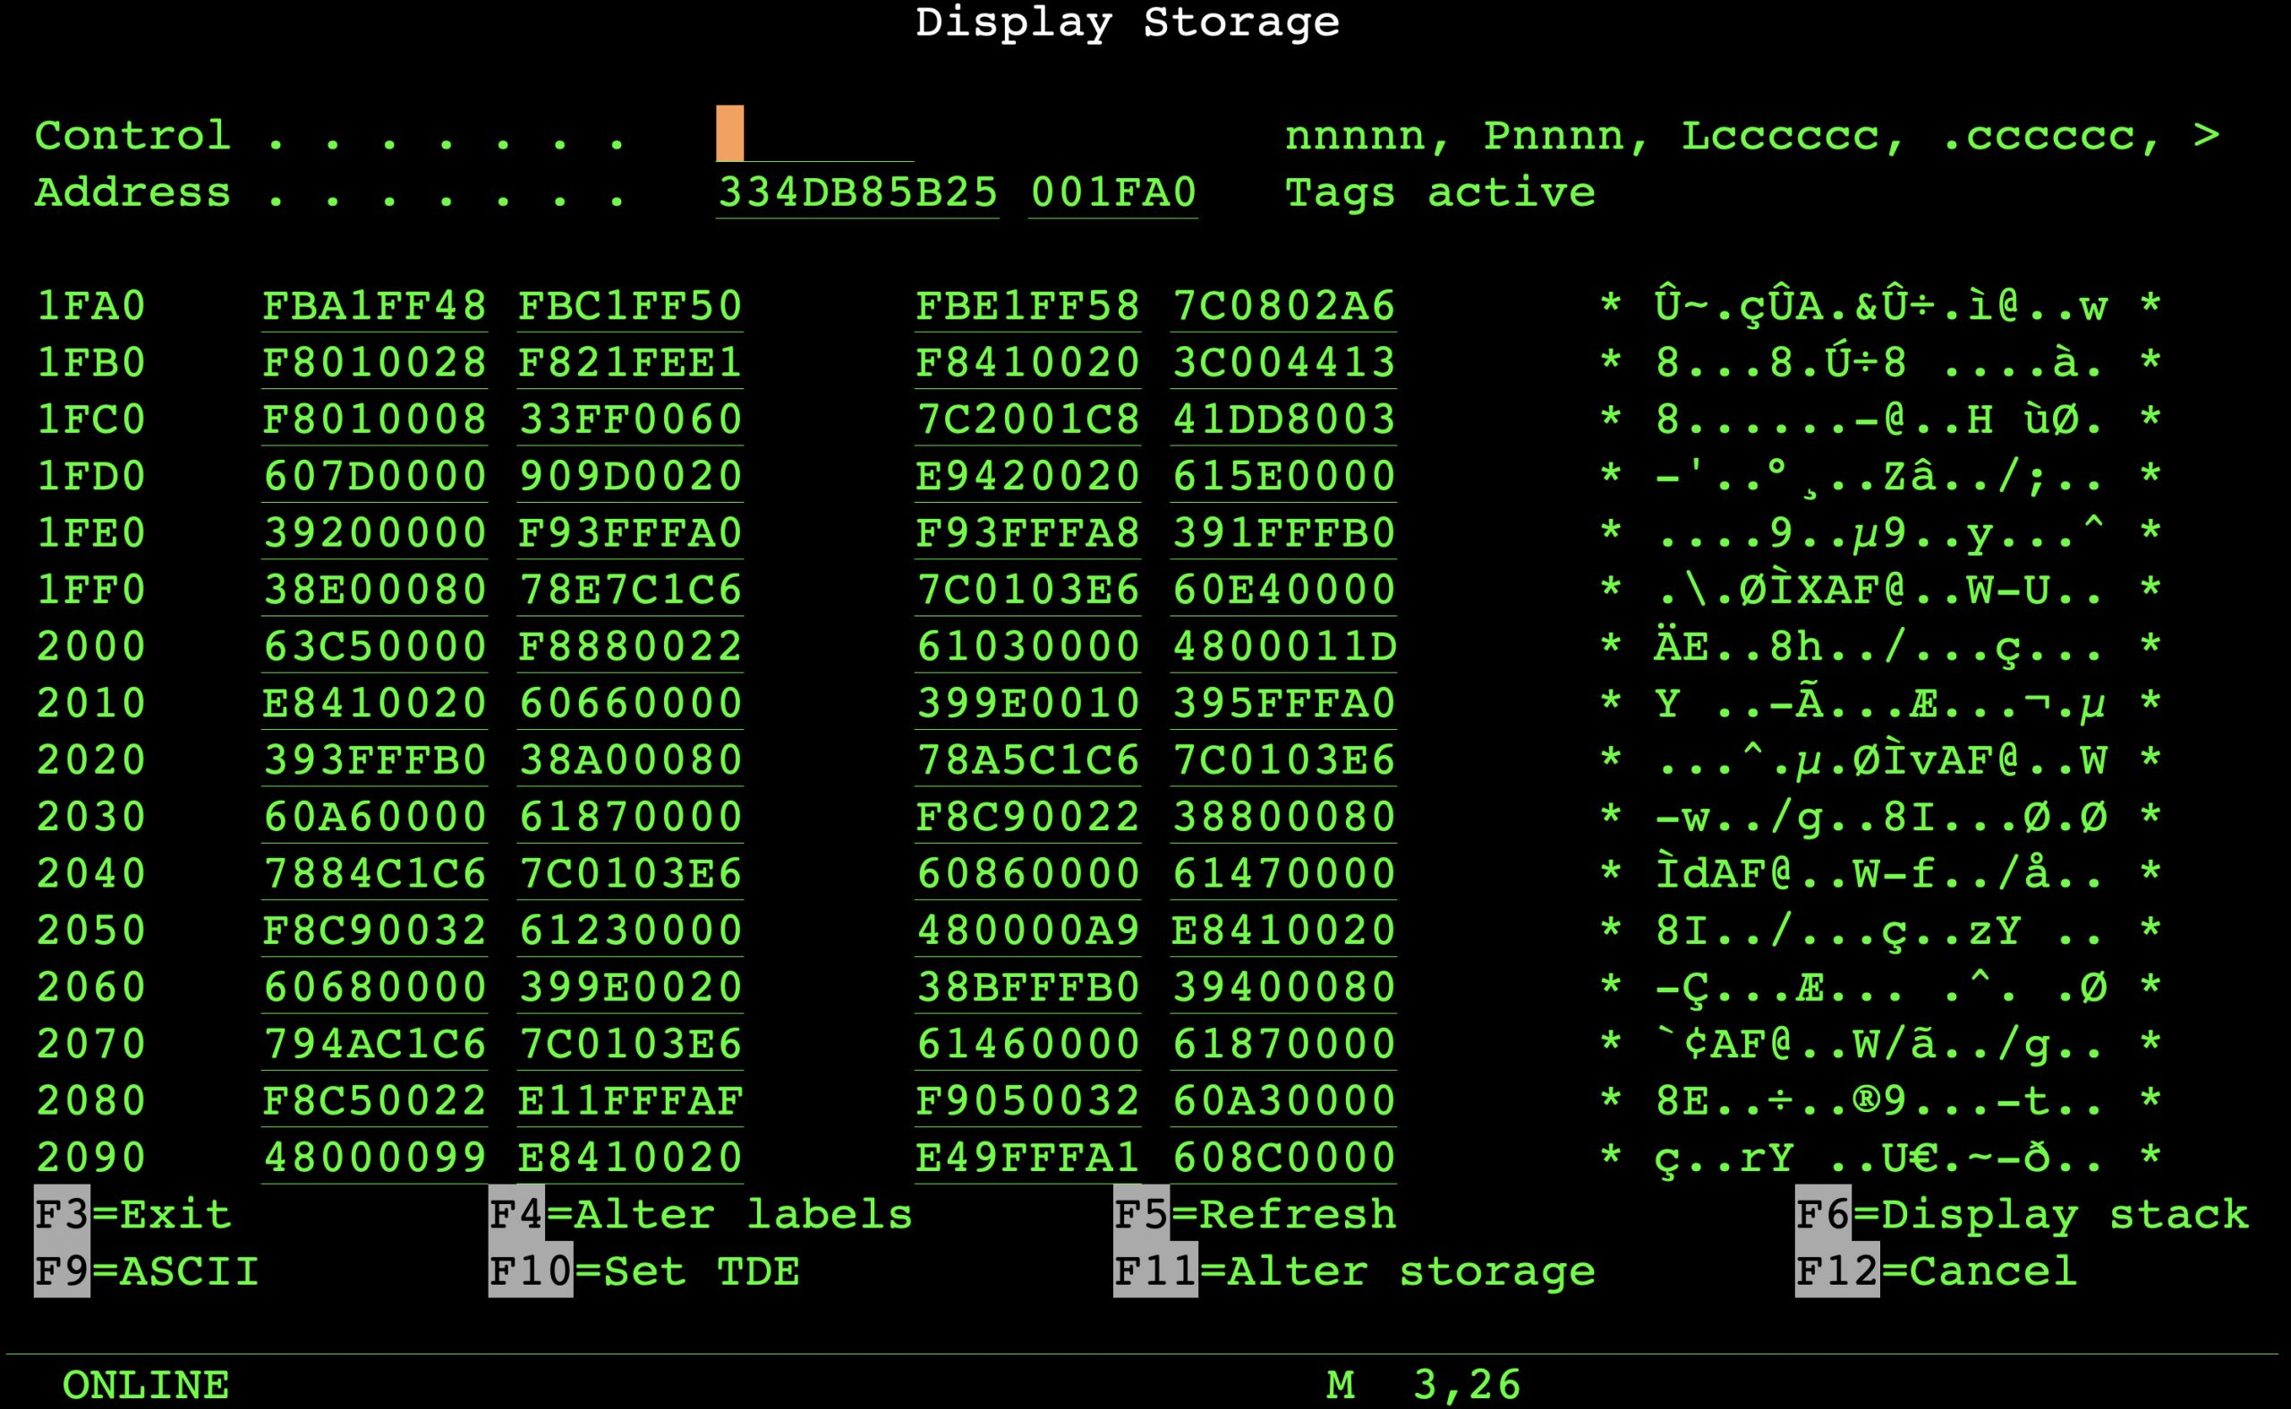



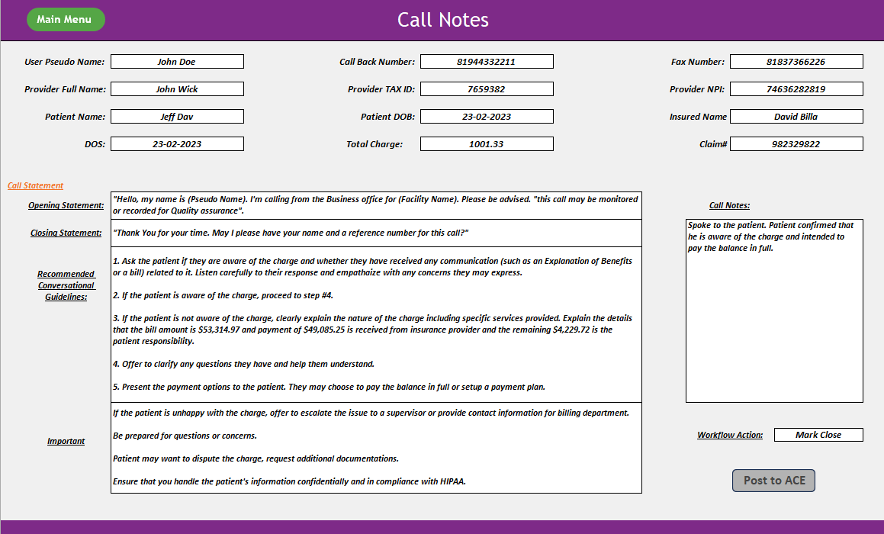
Solution Approach
Security & Governance
Associates
Knowledge Sourcing
Knowledge Interpretation
ACE
Know. Mgmt. System
Post Updates to ACE
Other Sources
M.E.S.H
Choose Account
Call Notes Data
Summarization Engine
Data Extraction
Can be removed
Account Information, Call Notes, Transaction/ Payment History
Summary view of current Account Status & Recommended next best action
Show Details

